Slide 1

A model is a representation containing the essential structure.
Notes:
Goldilock’s and the three modelers – need just the right amount of detail

Slide 2
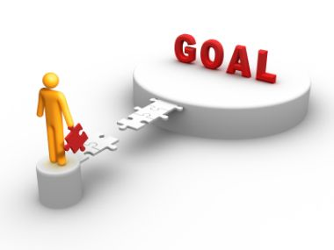
Rule #1: keep the goal in sight!
Think of a class you teach.
What learning goals do you have for that class—list both concepts and skills.
Notes:
Share your list with your neighbor, pick one or two learning goals to share with everyone. (I will write or type these as they are shared.)
Keep it simple and appropriate to the purpose of the model.
Concept <-> application
Novel definition and example of growth
Understand cycles and limits using specific examples
Place organisms in phylogenetic context & understand classes and functional groups

Slide 3
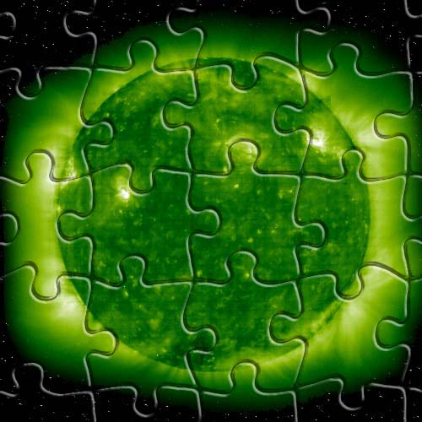
Let’s explore how constructing a model of photosynthesis using VenSim will address the learning goals for your classes.
Notes:
Bring up transport, energy budgets, primary producers, etc based on what participants mention
Look to emphasize common principles that generalize to other living systems, and fit it into larger issues and contexts

Slide 4
What is photosynthesis?
Our food and fuel
A part of every introductory biology class
http://www.biology.ualberta.ca/facilities/multimedia/uploads/alberta/Photo.html
Notes:
Ask for answers, write or type, add in any they miss

Slide 5
Why photosynthesis?
We will explore C3 and C4 photosynthesis and the implications for climate change and food .
Notes:
Ask for reasons, list on slide or whiteboard.
C3/C4 is a teaser, we’ll come back to this in a bit…let’s get into making a model now.
Think of it as an engineering challenge

Slide 6
VenSim uses a visual notation for component parts of models:
Box variable tool
Notes:
Ask CS folks for other examples of visual programming (eg Alice).
Here’s the ‘dictionary’ or vocabulary key. By the way, is there such a thing as a universal symbolic notation?
Definitions of symbols differ in Vensim, netlogo, etc. This is one reason that different modeling tools provide useful, complementary perspectives (and why some models are hard to translate to other tools…stochastic/deterministic, ask for examples of differential equations vs stochastic here)

Slide 7
You have an instruction sheet for making the first part of the example model. Go for it!
At the end of page 3 pause, we’ll talk more about the why and how at that point.
Notes:
We’ll come around and help or kibbitz…
When you have reached the end of page 3, think about those questions and we’ll talk more as a group about the processes, including C3 and C4.

Slide 8
C4 plants such as corn and sorghum grow better in dry conditions, as they can concentrate carbon dioxide rather than having to hold open pores and thus lose water vapor.
Climate change will favor C4 plants in much of the world.
http://beta.irri.org/projects15/en/c4rice
Notes:
Discussion about stomata – one way valve would keep in water
Discussion about limits on carbon fixation based on inputs

